Slide 1
Genetic Algorithms Optimizers

Slide 2
Optimization Algorithms
Why Genetic Algorithms?
Metaheuristic algorithms stemming from biological evolution.
Preferred for non-differentiable, expensive to differentiate, or objective functions with no intrusive access (black-box).
Doesn’t get stuck in local minima, and hence works with non-convex problems.
Can handle both constrained and unconstrained problems.
Due to the encoding/decoding step it works with discrete, continuous, or mixed design spaces, with binary, integer, real, gray, or permutation encoding.
2

Slide 3
Nomenclature
 | G1 | G2 | G3 | G4 | G5
ch1
ch2 | 2 | 5 | 1 | 8 | 4
ch3
ch4
ch5
ch6
ch7
Chromosome/individual (possible solution)
2 | 5 | 1 | 8 | 4
Population
2
Gene (variable)
2
Allele (value of variable)
3

Slide 4
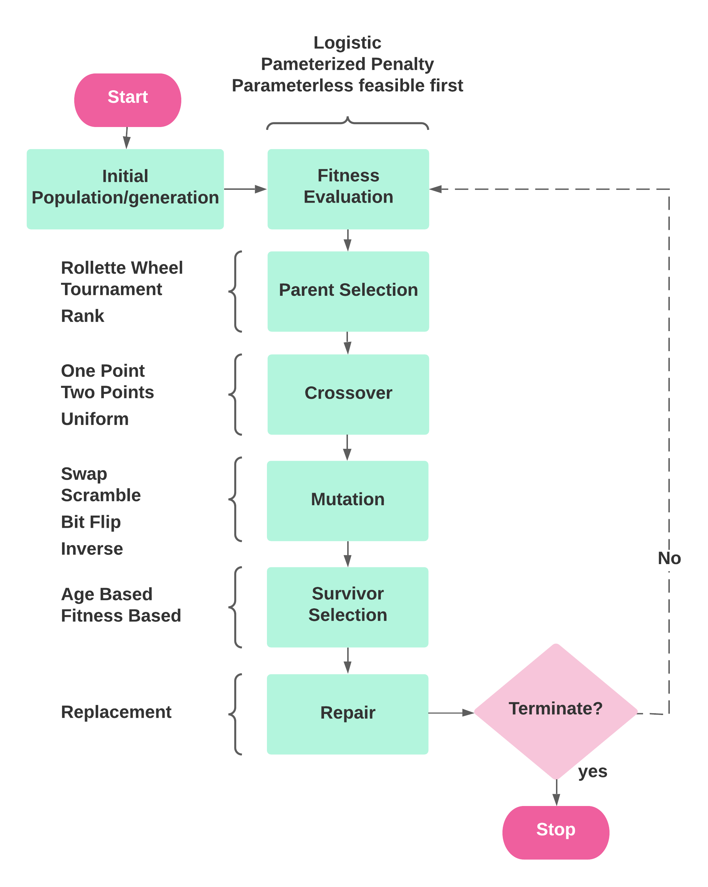
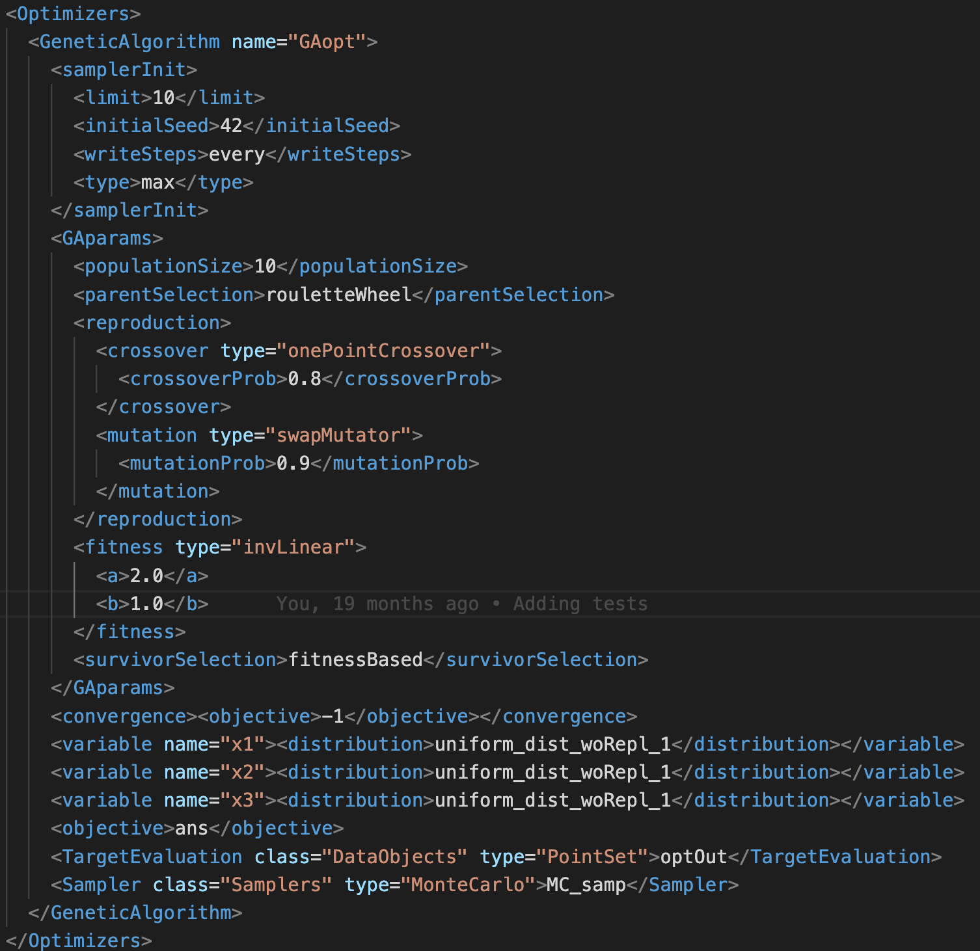
Flowchart and Corresponding Input
4

Slide 5
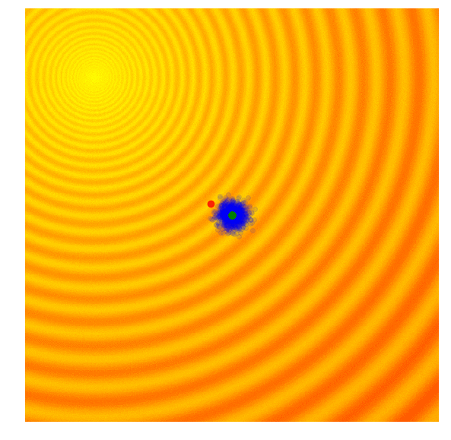
Overview of GA
1. Encoding/decoding: Phenotype/Genotype variable representation (binary, integer, permutation, or real representation).
2. Create initial population
3. Fitness Evaluation
4. Parent selection
5. Crossover: creation of offsprings
6. Mutation: creation of mutated offsprings
7. Replacement/repair
8. Survivor selection
9. If Termination condition(s) is met terminate, else repeat Steps 3 through 7 (each iteration is a generation).
Source: A Visual Guide to Evolutionary Strategies. https://blog.otoro.net/2017/10/29/visual-evolution-strategies.
5

Slide 6
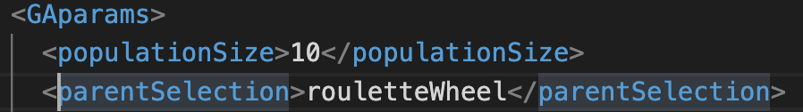
Evolutionary Operators for GA
Parent Selectors:
Roulette Wheel
Tournament Selection
Rank Selection
Individual | Fitness
P1 | 5
P2 | 8.2
P3 | 1.4
P4 | 0.98
P5 | 2
P6 | 2.3
6

Slide 7
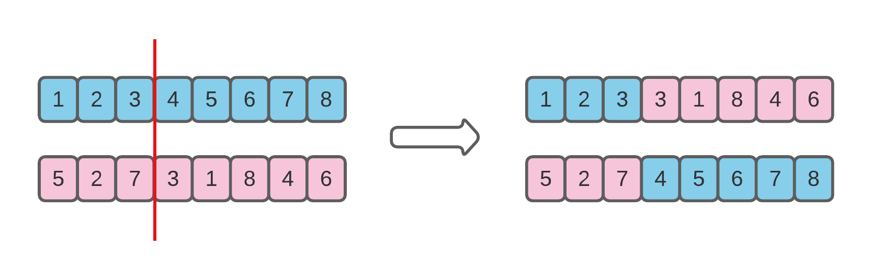
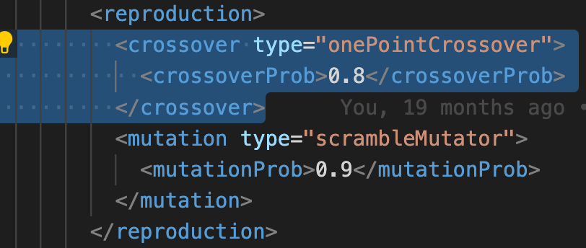
Evolutionary Operators for GA
Crossover:
One Point
Two points
Uniform
7

Slide 8
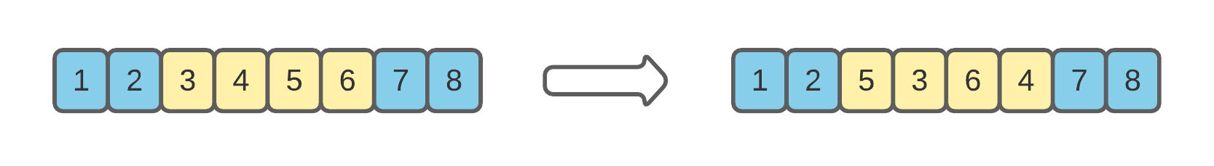
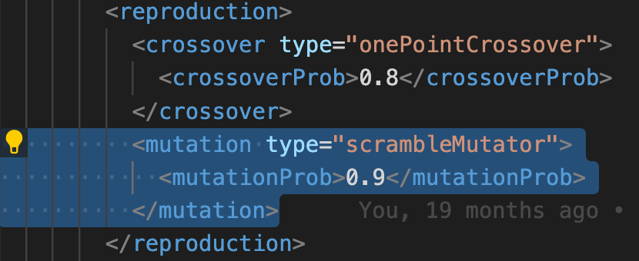
Evolutionary Operators for GA
Mutators:
Swap Mutation
Scramble Mutation
Bit Flip Mutation
Inversion Mutation
8

Slide 9
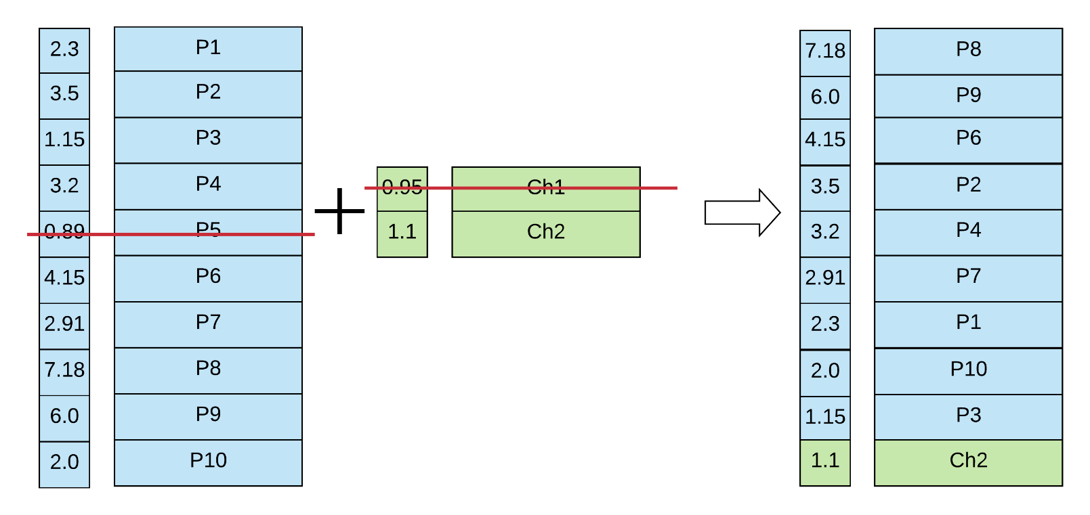
Evolutionary Operators for GA
Fitness
Chromosome
Fitness
Chromosome
Survivor Selection:
Fitness Based
Age Based
Fitness
Chromosome
offsprings
Generation/population i
Generation/population i+1
9

Slide 10
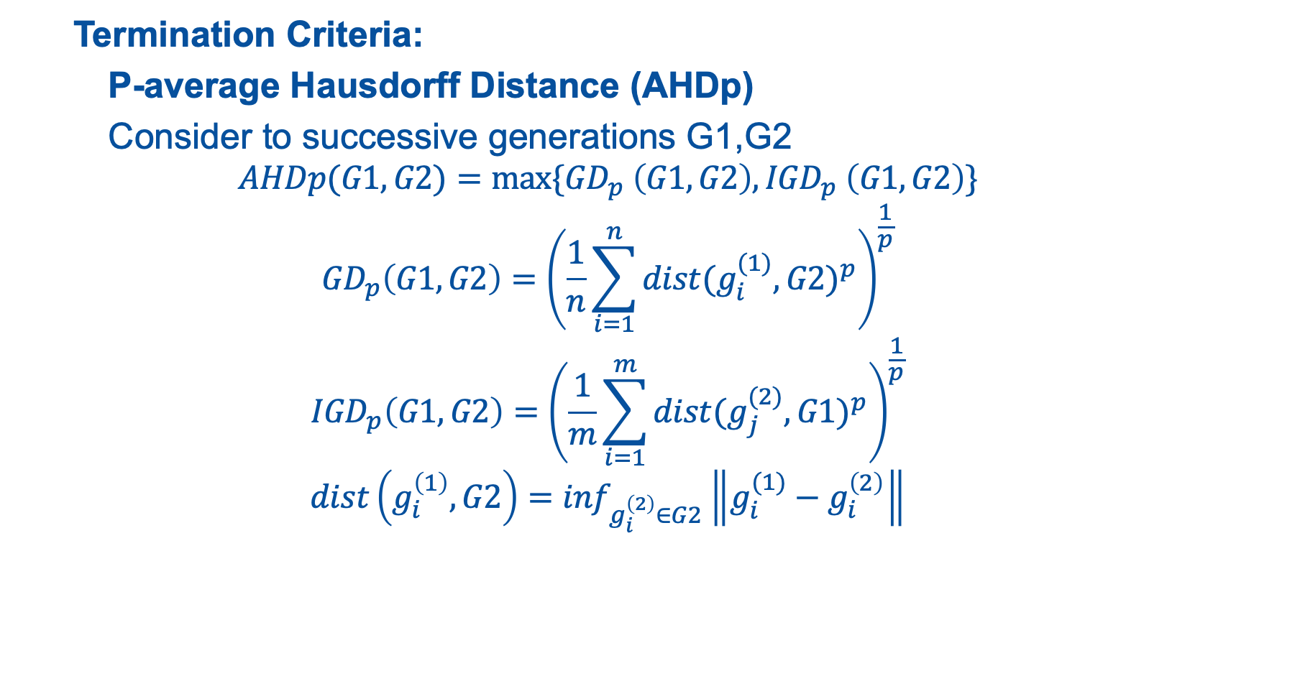
Evolutionary Operators for GA
Termination Criteria:
P-average Hausdorff Distance (AHDp)
Consider to successive generations G1,G2
$$AHDp(G1,G2)=max⁡\{{GD}_{p} \left(G1,G2\right),{IGD}_{p} \left(G1,G2\right)\}$$
$${GD}_{p}\left(G1,G2\right)={\left(\frac{1}{n}\sum_{i=1}^{n}{{dist(g_{i}^{(1)},G2)}^{p}}\right)}^{\frac{1}{p}}$$
$${IGD}_{p}\left(G1,G2\right)={\left(\frac{1}{m}\sum_{i=1}^{m}{{dist(g_{j}^{(2)},G1)}^{p}}\right)}^{\frac{1}{p}}$$
$$dist\left(g_{i}^{\left(1\right)},G2\right)=\inf_{g_{i}^{\left(2\right)}∈G2}\left\|g_{i}^{(1)}−g_{i}^{\left(2\right)}\right\|$$
10

Slide 11
Demonstration: Initial loading simplified problem
2D – Benchmark configuration
Settings:
1/4th of the core (PWR)
56 variables (56 assembly locations to arrange)
5 Materials (5 assembly types to “choose” from):
Material - 1: Enrichment 2.2% in U235, No burnable poisons
Material – 2: Enrichment 2.5% in U235, No burnable poisons
Material – 3: Enrichment 2.5% in U235, burnable poisons (8.e-06 #/(cm*barn))
Material – 4: Enrichment 3.5% in U235, No burnable poisons
Material – 5: Enrichment 3.5% in U235, burnable poisons (8.e-06 #/(cm*barn))
Objective:
Maximization of cycle length
The cycle length is determined based on a criticality search calculation (Soluble Boron Search): if SB <= 5 ppm, cycle ends
11

Slide 12
Demonstration: Initial results
Optimal solution:
Solution:
5 1 2 3 4 5 5 5 5 5 5 5
5 5 5 5 5 5 5 5 5 5 5 5
5 5 5 5 5 5 5 5 5 5 5 5
5 5 5 5 5 5 5 5 5 5 5 5
5 5 5 5 5 5 5 5
Optimal Value:
598.9 days
12

Slide 13
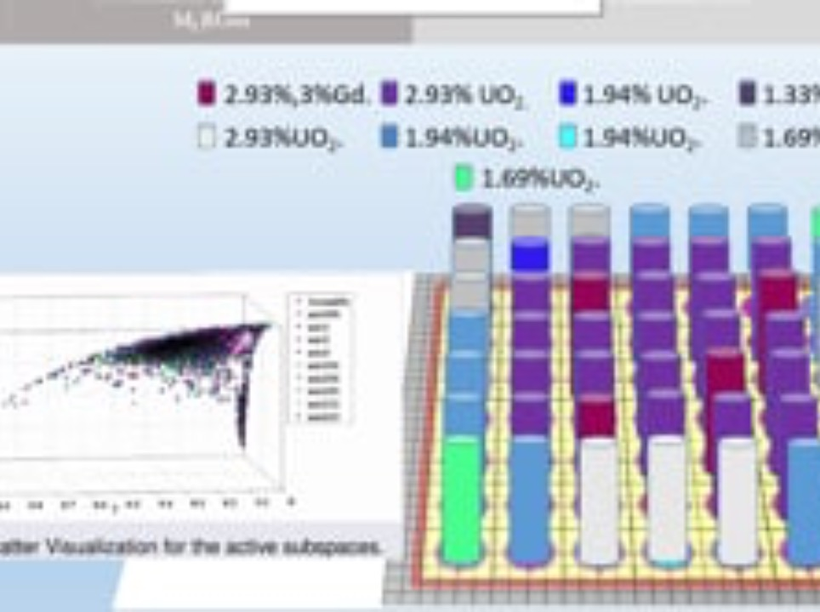
FY22 : Enhancements and Acceleration
Exploring the active subspace hosting the search directions that increase the fitness then constrain the mutation to these directions.
Accelerate GA with Markov Chains.
Recast the problem as a reinforcement learning problem:
Objective: Maximize Cycle length or minimize number of feeds.
Constraints: enrichment, number of GAD/burnable poison, K_{inf} , PPF, FDH,…
Action Space: Discrete fuel inventory
State Space: Fuel enrichment in each location.
Game Rules:
Do not violate constraints.
Do not place specific fuels next to each other (e.g., no GAD fuels horizontally or vertically adjacent).
Hybridizing and/or benchmarking with other metaheuristic methods: Particle Swarm, Ant colony, Bee algorithms, etc.
13

Slide 14
14

Slide 15
Backup Slides
15

